Slide 1
Employee Data Analysis using Excel
STUDENT NAME: KRITHIKA .R REGISTER NO: 312209093 DEPARTMENT: B COM A&F
COLLEGE: ANNA ADARSH COLLEGE FOR WOMEN NM ID: 1966F51712403BF8C0E43D4702E46C50

Slide 2
PROJECT TITLE
USING PIVOT TABLES FOR EMPLOYEE TURNOVER ANALYSIS

Slide 3


AGENDA
1.Problem Statement 2.Project Overview 3.End Users
4.Our Solution and Proposition 5.Dataset Description 6.Modelling Approach 7.Results and Discussion 8.Conclusion
3/21/2024 Annual Review

Slide 4

PROBLEM STATEMENT
Despite ongoing efforts to enhance employee satisfaction and retention, the organization has observed a rising trend in employee turnover over the past few years. The current turnover rate is higher than industry benchmarks, which could impact operational efficiency, employee morale, and overall organizational performance.
The organization lacks a comprehensive understanding of the turnover dynamics, including which departments, positions, or time periods experience the highest turnover rates.
Additionally, there is insufficient data-driven insight into potential underlying causes of turnover, such as department- specific issues, seasonal trends, or role-related factors.

Slide 5

PROJECT OVERVIEW
Introduction to the process of using Excel for data analysis.
Explanation of PivotTables for data summarization.
The role of charts/graphs in visualizing the summarized data.
Goal: To provide clear, actionable insights through this process.
Determine which departments or positions have the highest turnover rates.

Slide 6

WHO ARE THE END USERS?
An employee turnover analysis project using pivot tables, the end users are those who will utilize the findings and insights from the analysis to make informed decisions and take action.
The HR team is responsible for managing
employee relations, recruitment, and
retention strategies.
Senior managers and executives are responsible for strategic decision-making and overall organizational health.

Slide 7

OUR SOLUTION AND ITS VALUE PROPOSITION
The Performance Management Dashboard is a comprehensive Excel-based tool designed to analyze, visualize, and manage employee performance data efficiently. It provides a centralized platform where HR managers, department heads, executives, and other stakeholders can access, analyze, and act on performance data in a structured and insightful manner.
Enhanced Decision-Making
Increased Efficiency
Improved Performance Management
Actionable Insights
Scalability and Customization
Cost-Effective Solution
User Empowerment

Slide 8
Dataset Description
https://www.kaggle.com/models From this website the data has been taken.
Overview of the employee data being analysed.
Types of data: department, gender, salary, location, etc.
Importance of clean, well-organized data in Excel.
Preparation steps for the dataset before analysis.

Slide 9

THE "WOW" IN OUR SOLUTION
The dataset for the Performance Management Dashboard is designed to capture and analyze key aspects of employee performance. It consists of multiple data fields that provide a comprehensive view of each employee's performance metrics. Here’s a detailed description of the dataset structure and the significance of each data field:
Dynamic Data Summarization
Interactive Data Exploration
Customizable Views and Reports
Trend Analysis and Comparison
Visual Data Representation
Efficient Data Management
Advanced Filtering and Grouping
3/21/2024 Annual Review

Slide 10
MODELLING
To visualize employee performance data using a bar chart in Excel, follow these steps after setting up your data and creating a PivotTable:
Create a pivot table(if not already done)
Set up the pivot table
Insert a bar chart
Customize the bar chart
Update and refresh
Save and share

Slide 11
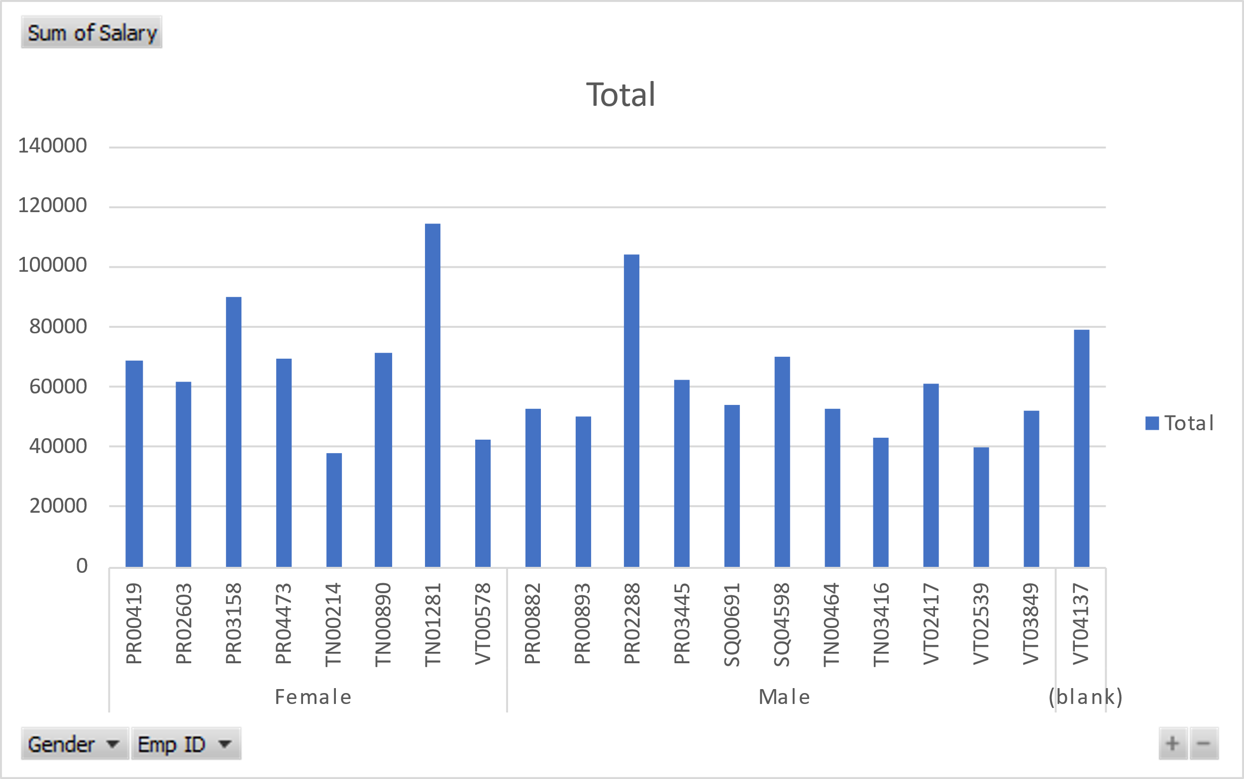
RESULTS
l
₃₅
113616.23
114691.03
_{100371.3}1₁02934.09
104335.04
107898.52
89690.38
90884.32₈₆₅9₅0₆6_{.9}9₆7.6₈7_{5455.53}
71570.99 73360.38
80169.42_{76320.44}
795677.868940.23
61994.76
63₅5₈5₉5₃.₅7.3_{9257419.35}
62169152.4174.26
50449.46
525926234.6.529 50310.09
44403.7₃7_{9700.8422314.39}
⁴³3³9²9⁹6.9².²72 40753.54
₃₅₉3₄8₃4_{.6}3₂8.24 _{31172.77}
37902.35
Total

Slide 12
conclusion
The analysis of employee turnover using pivot tables provides valuable insights into the patterns, trends, and underlying factors influencing employee attrition within an organization. By effectively utilizing pivot tables, the project aims to address key issues and support data-driven decision-making to enhance employee retention and overall organizational performance.
Understanding and addressing employee turnover is crucial for maintaining a stable and productive workforce. By leveraging pivot tables for turnover analysis, the organization gains a clearer picture of the factors affecting employee attrition and can implement more effective strategies to enhance retention and overall organizational success. The insights gained from this analysis provide a foundation for ongoing improvements and strategic planning, ensuring a positive impact on both employee satisfaction and organizational performance.

